Slide 1
Introducing Dell Technologies PowerStore
Designed for the Data Era
Notes:
Thanks again for taking the time to chat today. Just want to be cognizant of your time, I know you asked for a 20 minute presentation on the powerstore but just want to see if you have any hard stops?
Ok cool. I am excited to chat with you all today about the Powerstore… i know you have that Unity XT that is coming up on 5 years and are potentially looking to refresh. On our past conversations you mentioned that you were having some bottleneck issues with the Unity as you got closer to capacity and would like something that can meet your organization's needs for the future, not just today. You also mentioned you wanted an easy to use appliance as your team continues to get downsized and want to ensure you are optimizing your budget. Anything else I am missing that you are looking for in this new solution?

Slide 2


Dell Technologies introduces
PowerStore
Data-centric
Intelligent
Adaptable
Any Workload
Performance Optimized
Efficiency Without Compromise
V
Physical and virtual Apps and DBs, Containers and File
Scale up and scale out with end-to-end NVMe*
Always-on hardware-assisted data reduction
Ultimate workload flexibility
Notes:
Slide 1:
Going to see this slide a couple times throughout the presentation, but focusing on how the PowerStore is data centric, intelligent and adaptable
Starting with data centric:
Can handle any workload, performance optimized with its ability to scale up and out and end-to-end NVMe
We also offer efficiency without compromise by having always on inline data reduction

Slide 3

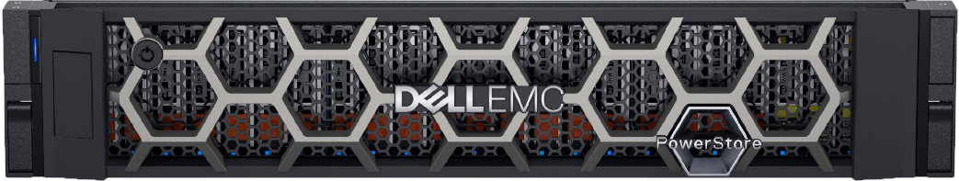

Any workload
Traditional and modern workloads
RELATIONAL
DATABASES
ERP
ELECTRONIC MEDICAL RECORDS
CLOUD NATIVE
CONTENT REPOSITORIES
HOME DIRECTORIES
FC | iSCSI
NVMe-oF
NFS | SMB
LUN
VM
vVol
FS
FS
FS
Apps and Databases
Containers
File
‹#›
Notes:
Slide 2:
PowerStore is the swiss army knife of storage by being able to take on any workload
Each of these workloads connect to the underlying infrastructure and different networking protocols
This is put all under one solution - that is specifically designed for any workload you throw at it

Slide 4
Optimized for performance
Node 1
Node 2
PowerStoreOS
PowerStoreOS
7x faster
3x lower latency
All NVMe-based drives – SCM or Flash
PowerStore
Based on internal testing versus Unity XT
Active-Active HA | End-to-end NVMe | Flash or SCM
Designed for 99.9999% availability
‹#›
© Copyright 2020 Dell Inc.
Notes:
Slide 3:
PowerStore is designed to maximize performance and eliminate bottle necking and this is achieved with its active active architecture
This means that both of the controllers are online and servicing IO's at the same time
This is an all NVME solution so we are utilizing all NVMe based drives whether they are SCM memory drives or NVME based SSD drives
This really is a performance centric solution

Slide 5
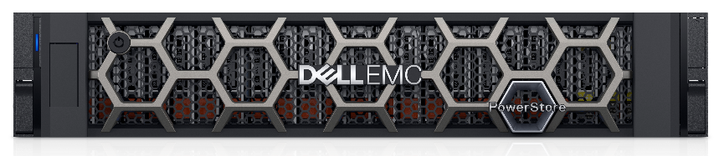
Always-on data reduction minimizes cost
Intelligent dedupe + compression
5:1
data reduction
GUARANTEED
No management required
Consistent storage efficiency without compromise
‹#›
Notes:
Slide 4:
PowerStore has always on inline data reduction
What this means is that PowerStore will compress and dedupe your data before storing it onto the array so less capacity is needed right off the bat
We also have a 4:1 data reduction guarantee where you'll sign a contract and if for some reason your PowerStore does not mean the 4:1 DRR, we will do everything in our power to resolve, like adding new drives for free
An important thing to note with this data reduction guarantee is that we see this level of dedupe and compression on what we call applicable workloads which is those block workloads -- not unstructured

Slide 6
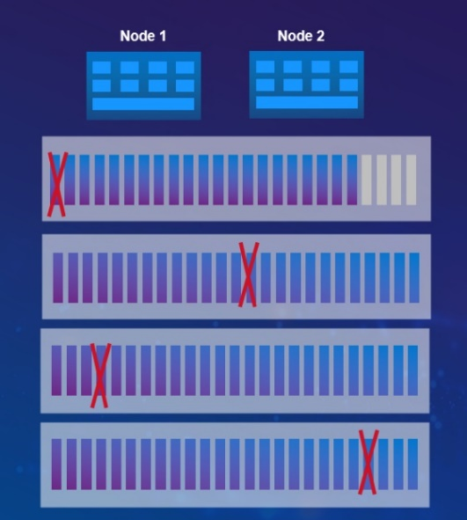
Dynamic Resiliency Engine
Virtualized parity domains not tied to physical drive groups
Start with as few as 6 drives, expand non-disruptively, one drive at a time. Automatically assimilates drives.
Distributed spare capacity reduces risk by enabling faster rebuilds
Improves performance, all drives house data, contribute IO
Multiple fault domains dynamically expand as more drives are added
Multiple technology advantages working together
Redundancy extents
Distributed sparing
+
+
Single- and mixed-drive expansion
In event of a drive failure, DRE restores original protection levels without manual intervention, before drive replacement.
Resiliency sets
Notes:
Slide 5:
Now we're going to get into PowerStore's Dynamic Resiliency Engine
This is a software defined approach to redundancy
It's going to be more distributed, automated and efficient than traditional RAID
So if we look at these different aspects of DRE, we have redundancy extents which are virtualized parity domains that are spread across multiple drives
This is what allows you to have single or mixed drive upgrades. So instead of having to add an entire RAID group every time you need to expand, you can just do it 1 drive (or 2 or 3) at a time
The great thing is that you still get the same level of protection with DRE as you do with traditional RAID
There also is distributed sparing where instead of having an entire dedicated hot spare drive, it's broken up into smaller chunks and spread across all the drives
So no drive sits idle
In the case that there is a failure, rebuilds are much faster since more drives are involved. Instead of rebuilding to a single spare, it's rebuilding smaller chunks across multiple drives and only the data that has actually been written to the failed drive is rebuilt
It's very efficient and with DRE, these faster rebuild times will reduce exposure to risk
PowerStore also implements resiliency sets, which are these fault protection domains that increase the reliability of the system by allowing the appliance to tolerate simultaneous drive failures in each of the sets
SIDE NOTE: this comes into play if you have more than just a base enclosure
Sets are the enclosures themselves

Slide 7



Fully distributed architecture
RAID geometry not tied to physical drive groups. Flexible Redundancy Extents enable
Single/mixed-drive expansion
Enterprise-class availability
DRE optimizes performance, availability, flexibility & cost
Node 1
Node 2
Replaced drive
Replaced drive
Parity protection is calculated and maintained within each virtualized Redundancy Extent.
IN THIS EXAMPLE:
Two drives have failed and been rebuilt
Zero workload interruption
Original protection level has been restored
Still haven’t had to touch the array!
Dynamic Resiliency Engine
Intelligent, automated protection for the data era
_{Spare}
_{Spare}
_{Spare}
Volumes are virtualized independently from chunks or redundancy extents ( = Vol A, = Vol B, etc.)
Writes to any volume go to the next available chunk and extent (do not need to be contiguous)
_{Spare}
_{Spare}
_{Spare}
_{Spare}
_{Spare}
_{Spare}
_{Spare}
_{Spare}
_{Spare}
_{Spare}
_{Spare}
_{Spare}
_{Spare}
_{Spare}
_{Spare}
_{Spare}
_{Spare}
_{Spare}
_{Spare}
_{Spare}
_{Spare}
_{Spare}
_{Spare}
Distributed sparing
Rebuilds only written data to spare space on multiple drives (FAST!)
Intelligently prioritizes IO during rebuild
Automatically replenishes spare capacity
System assimilates and rebalances expansion and/or replacement drives without manual configuration
Notes:
Slide 6:
Here is a detailed animation on how DRE works and how it intelligently combines all the capabilities I highlighted in the previous slide
CLICK
So first here we are seeing the data being striped across the drives, this is the redundancy extents that we talked about on the previous slide
CLICK
This is the spare space being distributed across all of the drives
CLICK
If a drive fails, click, PowerStore will take the written data and rebuild it across the spare spaces
CLICK
Then, it will replenish the spare spaces that were just used
CLICK
Now say there was another drive failure, the same process as the first drive failure will happen without any workload interruptions
DOUBLE CLICK
The only thing that you would have to do is replace the failed drive and PowerStore using AI and ML will rewrite the data from the spare space to the new drive
CLICK
And this just shows that the user data volumes are distributed across an entirely different layer of abstraction and aren't bound by physical drives, redundancy extents or physical sets
CLICK
This is all done automatically by the PowerStore system and is fully transparent to the administrator

Slide 8
Dell Technologies introduces
PowerStore
Data-centric
Intelligent
Adaptable
Programmable Infrastructure
Autonomous Appliance
Proactive Health Analytics
Streamlines development and automates workflows
Built-in automation and ML optimizes system resources
Smart monitoring to reduce risk and predict future needs
Autonomous, consistent operations
Notes:
Slide 8:
Coming back to the first slide, we talked about how PowerStore is data centric, now we'll talk about how it's intelligent

Slide 9





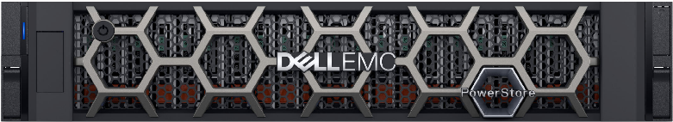
Programmable infrastructure
Enabling automation and DevOps
Automated end-to-end workflows Self service catalog
Automate storage provisioning processes
Deploy new resources in seconds vs days*
Eliminate manual steps to reduce risk
DevOps
Nutanix
Kubernetes
Ansible
REST API
*Assumes multiple teams and manual approval process
‹#›
© Copyright 2020 Dell Inc.
Notes:
Slide 9:
And finally, PowerStore AUTOMATES and streamlines your overall workload environment with a programmable architecture that integrates leading DevOps, containerization and open management frameworks – including VMware, Kubernetes, Ansible, ServiceNow and more. By automating PowerStore functions within these frameworks, administrators can deploy new services in seconds vs. days, eliminating dozens of manual provisioning steps.

Slide 10

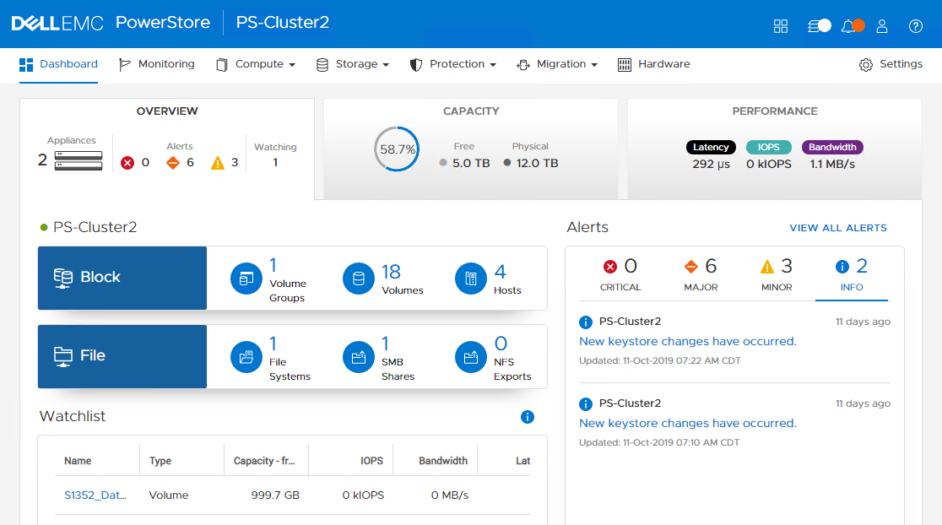

PowerStore Manager
Simple, modern, intuitive management and monitoring interface
Management Interface HTML5-based GUI for managing PowerStore clusters. No Java required
Supported Browsers Chrome, Firefox, Internet Explorer, Edge, Safari
APEX AIOps Integration Easy access to AIOps via PowerStore Manager
Internal Use - Confidential
‹#›
© Copyright 2020 Dell Inc.
Notes:
Slide 11:
PowerStore manager - all of the features and management tasks that the PowerStore allows can be done through the HTML5 faced GUI called PowerStore manager
Previous array management systems have been java based and much less user friendly
This sleek, easy to use HTML5 interface allows you to gain insights on your arrays performance, provision storage, load balance, resolve issues within the environment and more

Slide 11



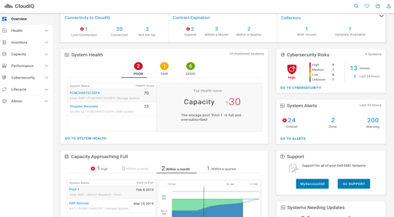
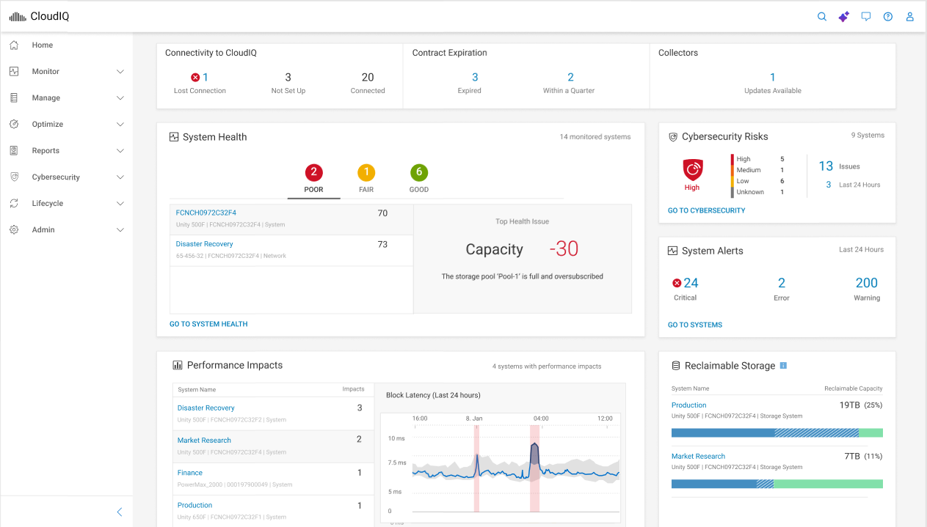

New GenAI Assistant
Simplify complex topics
Now have a “conversation” with your APEX AIOps tools!
“Walk me through the steps for a data-in-place upgrade.”
“Explain PowerStore DevOps automation to me like I’m eight”
“What does a 0x02C00301 error code mean?”
“Can you write an email to my boss from that response?”
Get custom, high-quality answers in seconds
APEX AIOPs Infrastructure Observability
Access from every screen
Natural language synthesis of
133,000+ Knowledge Base articles
User manuals, reference guides, release notes for every Dell product
Trusted expertise
Trained on official Dell Engineering docs only
Titles displayed, dated, linked with each response
Alerts you if issue requires Dell’s support
Save hours of research, resolve issues faster
‹#›
Copyright © Dell Inc. All Rights Reserved.
Notes:
Slide 12:
APEX AIOps (artificial intelligence for IT operations) is a software-as-a-service suite designed to simplify IT operations, increase team agility, and enhance control over digital infrastructure. It has 3 key components:
Infrastructure Observability:
This component ensures the integrity of Dell infrastructure by monitoring health, cybersecurity, and sustainability. It uses AI to transform high-volume event noise into actionable incidents with root cause analysis and recommendations. Features include health and cybersecurity scores, performance and capacity forecasting, and integration with various system managers. It is included at no additional cost for products with a valid ProSupport (or higher) contract.
Application Observability:
This component provides total visibility into application performance by correlating application health with underlying infrastructure. Key features include automatic application discovery, dependency mapping, and real-time anomaly detection. This helps significantly reduce the mean time to resolution (MTTR) for application issues. It is available as a subscription-based add-on.
Incident Management:
This component automates the incident lifecycle to optimize service availability by reducing alert noise, correlating alerts into actionable incidents, and facilitating cross-functional collaboration. It integrates with IT service management (ITSM) tools like ServiceNow, and automation tools for self-healing. This results in significant reductions in event noise, tickets, and customer-reported issues.

Slide 12
Dell Technologies introduces
PowerStore
Data-centric
Intelligent
Adaptable
Flexible Architecture
Flexible Deployment
Flexible Consumption
Enables speed and application mobility
Modernize the core, edge, and cloud without disruption
Choice, predictability, and investment protection
Continuously modern and highly adaptable
Notes:
Slide 13:
Last thing to cover here is powerstore's high adaptability

Slide 13

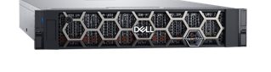
Adaptable architecture evolves with your needs
Extends solution life to accommodate ANY future
Add performance or capacity independently
Self-configuring services
Unprecedented data and application mobility
Auto-discovery
Resiliency
Scale up Single-drive granularity
Security
Data
Data
Data
Data
Data
Data
Data
Data
Data
Data
Data
Data
Data
Data
Data
Data
Data
Data
Data
Data
Scale out
Notes:
PowerStore’s unique adaptable architecture evolves physically AND operationally with your needs. Right out of the box, you’re getting an incredible amount of advanced technology designed to accommodate change.
[CLICK] PowerStore is very easy to EXPAND. You can start small, then add capacity or performance independently. Unlike other storage platforms, you can Scale UP in single-drive increments …or Scale OUT in intelligent clusters to over 18 PB effective capacity!
[CLICK] As you expand, all storage services are configured automatically, with ZERO manual effort, as soon as you insert a new drive.
[CLICK] And finally, Intelligent clustering gives you unprecedented data and workload mobility, letting you rebalance resources quickly with no impact to your external hosts.
But the flexibility doesn’t stop there…
[CLICK to next slide]
-----------
ADDITIONAL BACKGROUND: COMPETITIVE NOTES
Pure
PowerStore’s single-drive expansion capability helps you target precise cost/performance goals without overbuying.
Pure has no granular scale-up – you have to add drives in packs of 6, 10 or 14 depending on system. Plus, you need to upgrade controllers to support increasing capacity, whereas PowerStore supports each appliance’s full capacity without an upgrade. Pure’s architecture is active/passive with performance limitations.
No scale-OUT or federation.
NetApp
Deployments can take hours, requiring specific NetApp expertise or professional services.
Management requires more than one GUI.
Scale-out is a complex and manual process.

Slide 14
Scale out with multi-appliance clusters
Scale UP
to 5.9 PBe per appliance*
Scale OUT (4 appliances, 8 nodes)
to >23 PBe per cluster*
Node 1
Node 2
Node 1
Node 2
Node 1
Node 2
Node 1
Node 2
CAPACITY
PERFORMANCE
Expand compute and storage independently
*Effective capacity assumes 5:1 DRR
Notes:
Scaling up and out independently is amazing and is a key feature you are currently missing out on with your Unity XT, so lets chat a little more about what this means for your organization
[CLICK]
Advanced clustering technology allows PowerStore to scale system capacity by adding expansion enclosures and….
[CLICK]
….processing power by clustering up to four appliances/8 active-active nodes together. And with intelligent resource balancing, PowerStore can automatically balance storage and workloads to maximize system utility.
Additional notes:
By clustering up to four PowerStore appliances together, users can manage the combined nodes and capacity as a single storage space using the PowerStore Cluster Manager.
While individual appliances each manage access to the storage under their control, volumes and workloads can be moved seamlessly between appliances to rebalance storage and optimize resource utilization across the cluster.
Though designed to ensure user control, the Cluster Manager is also able to provide alerting and intelligent rebalancing recommendations along with automated move function, eliminating administrative overhead.
With the PowerStoreOS 2.0 release, clustering is available for both T and X models, which we’ll discuss shortly.

Slide 15
Mixed clusters target specific workload needs
Flexible performance & application segregation
Oracle
Efficiency, consolidation
Nutanix
Rich data services
High Capacity
Lower cost, scalable
Ultra-high performance
SCM media
PowerStore 5200T
PowerStore 3000T
PowerStore 3200Q
PowerStore 9200T
CAPACITY
PERFORMANCE
Performance varies by model
Same software features, same max capacity
Notes:
To provide additional flexibility, different PowerStore models (1000, 3000, 5000, 7000, 9000 can be mixed in the same cluster. This allows IT organizations to select the right appliance model/configuration for their specific workload(s), ensuring optimal performance, availability, and efficiency based upon the requirements.
You can have a single system to support the different workloads and right size yoru environment so you aren’t overpovisioning or underprovisioning resources.
Additional notes:
Intelligent clusters are now supported for both PowerStore T and PowerStore X models -- although each cluster must be composed of either all T or all X models. Again, numerical models may be mixed as needed.

Slide 16




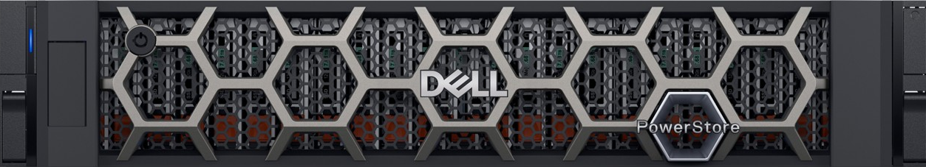

Modular, container-based OS
Continuously modern design
PowerStoreOS
Microservices architecture helps PowerStore itself evolve faster.
Shared capabilities across platforms
Future deployment models
Notes:
Slide 14:
PowerStore uses a container based software architecture called PowerStore OS
The container-based OS enables rapid software evolution and non-disruptive upgrades. This ensures customers always have access to the latest features and improvements without any downtime
By isolating individual OS components as microservices, the container architecture boosts performance and enhances fault tolerance. This results in more reliable and efficient operations.
But that’s not all we do to make it more adaptable for our customers needs…
Simplified Integrations: The OS supports seamless integration with existing and future applications, such as AppSync, SRM, and Data Protection Suite. This modularity allows for easy feature portability and rapid deployment of new capabilities.
Efficiency Boost: PowerStore's integrated intelligence auto-tunes efficiency and performance, reducing manual intervention. It features self-optimizing capabilities that continuously improve performance over time.

Slide 17
Lifecycle Extension with ProSupport
The simplest way to keep your infrastructure continuously modern
Optimize every phase of storage ownership
World-class support services
Customized annual consultations
Flexible technology upgrades
+
+
Adopt PowerStore’s flexible, software driven architecture
and subscribe to Lifecycle Extension with ProSupport or ProSupport Plus
24/7 access to live experts
no call-backs, ever² predictive hardware anomaly detection, access to insightful dashboards³
An appointed technical advisor
proposes efficiency improvements for your PowerStore and advises on available technology upgrades for your changing business needs
Meet your unique business needs
adopt higher model upgrades, capacity refreshes, scale-outs, and next generation appliance upgrades¹
Up to 25% cost savings!⁴
All subscribers also benefit from Future-Proof Program guarantees
Tech Refresh & Recycle | All inclusive software | Data reduction guarantee | 3-year satisfaction guarantee
¹Requires 6 year contract
²Courtesy of ProSupport or ProSupport Plus
³APEX AIOps Infrastructure Observability and MyService360 dashboards
⁴Subscribers of Lifecycle Extension with ProSupport or ProSupport Plus save up to 25% when upgrading their storage product using the program's qualified upgrades -compared to those without the program. 6-year contract required. Refer to your sales representative for more details
Notes:
I know early we spoke about how you can scale up and out, but this takes it one step further when it comes to lifecycle management and flexible tech upgrades to meet our customers needs.
Today’s volatile economic and technology landscape makes the future harder to predict than ever – and customers kept teling us how difficult it was to juggle separate support contracts, upgrade programs, and simultaneously deal with the complexity of managing modern IT, especially as they conetinue to get downsizeded
With that in mind, it just made sense to combine PowerStore's foundational adaptability with everything customers need to maintain, upgrade, and optimize their appliance in a single, easy-to-understand offering. Based on the popular Anytime Upgrade program, we’re proud to introduce a new and greatly enhanced streamlined offering: Lifecycle Extension with ProSupport.
This offering combines Dell’s world-class ProSupport services with flexible technology upgrades and technical advisory services to simplify every phase of storage ownership.
From Day 1, customers get best-in-class enterprise support aligned to the criticality and complexity of their systems, including
24/7 access to live experts (no call-backs, unlike competitors).
Benefit of Dell’s predictive anomaly detection tools,
Access to insightful dashboards for incident tracking and resource management ***
As their solution evolves, Lifecycle Extension takes the stress out of planning for periodic storage upgrades with an appointed technical advisor who stays tuned in to the customer’s business needs, recommending efficiency improvements and helping them make informed decisions to optimize performance and cost.
And finally, when it’s time to implement a change, Flexible Technology Upgrades make the process completely painless and cost-effective, saving your business up to 25% when upgrading! From data-in-place upgrades to boost performance to scale-out, capacity refreshes, or next-gen platform upgrades, Lifecycle Extension is the simplest, most cost-effective way to stay current with the latest PowerStore advancements.
And of course all subscribers benefit from Dell’s Future-Proof program guarantees, as we’ve discussed.
[CLICK to next slide]
*Requires 6 year contract
**Courtesy of prosupport or prosupport plus
***APEX AIOps Infrastructure Observability and MyService360 dashboards

